Slide 1
NFL Draft App Storyboard
This is my own work
Brandon Johnson
Computer Programming 1
8/20/2017

Slide 2
Process Flow
HQ Page
Avail. Players
Roster
Available Players
Add to Roster
Remove from here
Roster
Remove from here
Add to Available
Login

Slide 3

Welcome to the NFL Draft App
HaslamJ
D@wgPound17
Notes:
Retrieved Image 8/20/2017 from: http://www.wkyc.com/img/resize/content.wkyc.com/photo/2016/04/14/635772342385883779-Browns2_1460679062198_1629326_ver1.0.JPG?preset=534-401

Slide 4

Headquarters
Available Players
Roster
Notes:
“Available Players” button takes user directly to ‘Available Players’ page
“Roster” button links directly to ‘Roster’ Page
Image retrieved from: https://s3media.247sports.com/Uploads/Assets/461/948/4948461.jpg, 8/20/2017

Slide 5
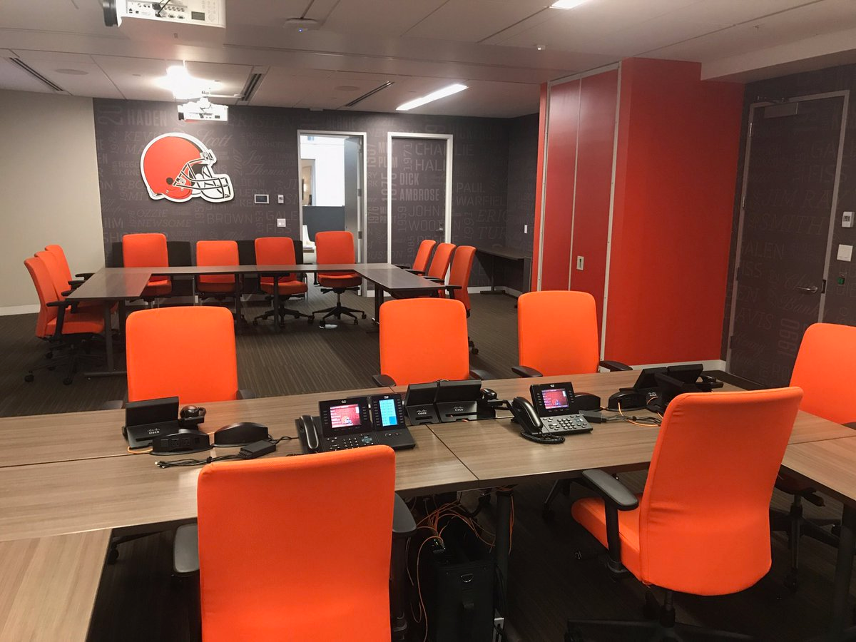
Available Players
Defense
Offense
+ | Cody Kessler | QB | Yards | Attempts | Completions | Touchdowns
 |  |  | 1380 | 195 | 128 | 6
+ | Jamie Meder | DT | Solo Tackles | Total Tackles | Assisted Tckls | Sacks
 |  |  | 26 | 48 | 22 | 1
+ | Jamie Collins Sr | LB | Solo Tackles | Total Tackles | Assisted Tckls | Sacks
 |  |  | 48 | 69 | 21 | 2
+ | Rashard Higgins | WR | Receptions | Targets | Yards | Touchdowns
 |  |  | 6 | 12 | 77 | 0
+ | Isiah Crowell | RB | Attempts | Yards | Avg | Touchdowns
 |  |  | 198 | 952 | 4.8 | 7
+ | Briean Boddy-Calhoun | DB | Solo Tackles | Total Tackles | Assisted Tckls | Sacks
 |  |  | 39 | 43 | 4 | 1
Notes:
“+” Adds player to Roster
Back button takes user back to Headquarters
Image retrieved 8/20/2017 from: https://pbs.twimg.com/media/C-bTmxLWsAEkJyF.jpg

Slide 6
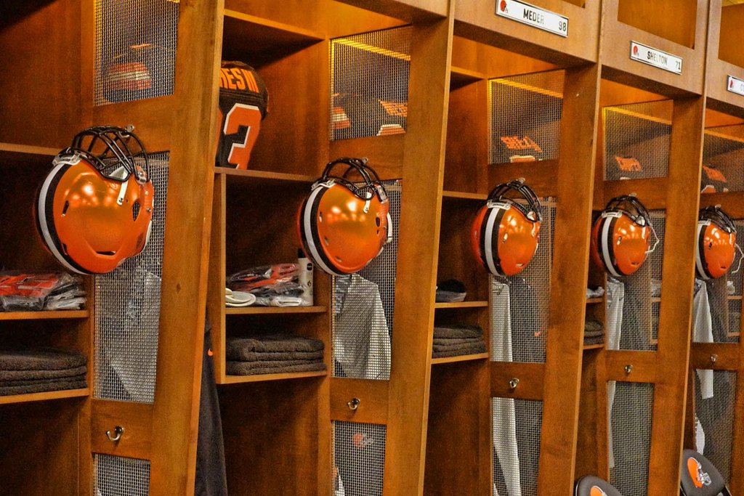
Roster
Defense
Offense
X | Cody Kessler | QB | Yards | Attempts | Completions | Touchdowns
 |  |  | 1380 | 195 | 128 | 6
X | Jamie Meder | DT | Solo Tackles | Total Tackles | Assisted Tckls | Sacks
 |  |  | 26 | 48 | 22 | 1
X | Jamie Collins Sr | LB | Solo Tackles | Total Tackles | Assisted Tckls | Sacks
 |  |  | 48 | 69 | 21 | 2
X | Rashard Higgins | WR | Receptions | Targets | Yards | Touchdowns
 |  |  | 6 | 12 | 77 | 0
X | Isaiah Crowell | RB | Attempts | Yards | Avg | Touchdowns
 |  |  | 198 | 952 | 4.8 | 7
X | Briean Boddy-Calhoun | DB | Solo Tackles | Total Tackles | Assisted Tckls | Sacks
 |  |  | 39 | 4 | 43 | 1
Notes:
“x” Removes player from Roster
Back Button takes user back to Available Players
Image retrieved 8/20/2017 from: https://pbs.twimg.com/media/CXzgVplUwAAm-yb.jpg:large

